Slide 1
Learning Your Data: Data Processing of Genetic Data.
Benjamin Kaufman
PhD Student in Human Genetics

Slide 2
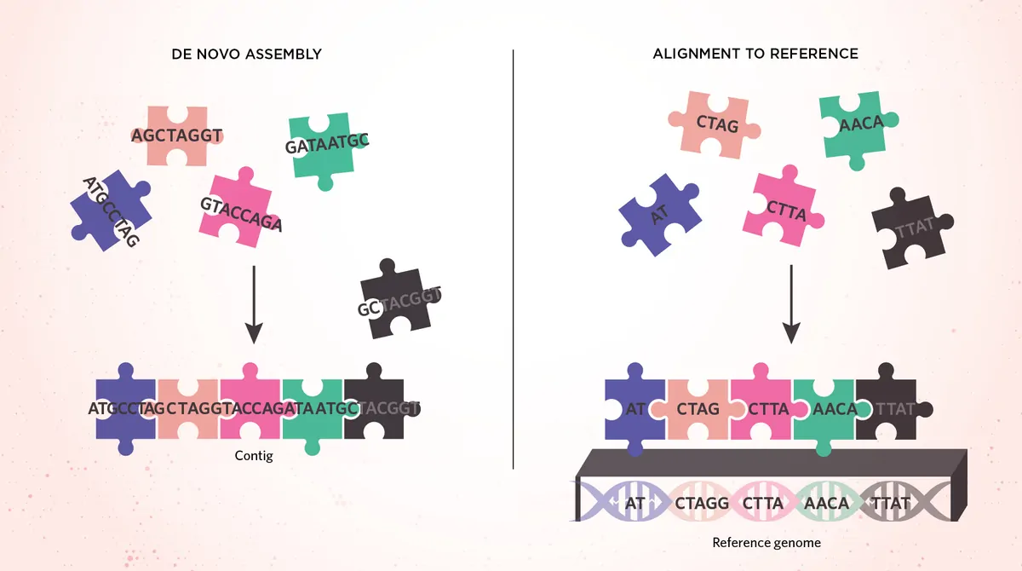
What is Genome Build?
A human genome reference build is essentially a "standard map" of human DNA - it's the agreed-upon sequence of all 3 billion DNA letters that serves as the universal reference point for comparing everyone else's genomes
MODIFIED FROM © ISTOCK.COM, FILO

Slide 3
What is a Genome Build?
hg18 (GRCh36)
Debut: 2006
hg19 (GRCh37)
Debut: 2009
GRCh38
Debut: 2013
Next Build?
Stay tuned!
As sequencing technology improves and we discover more about human genetic variation, the Human Reference Genome is updated to fix errors and fill in gaps. Each iteration of the Reference Human Genome is called a build!
The builds essentially represent snapshots of our best knowledge at the time.
As technology gets better, we can sequence harder regions, fix mistakes, and create more accurate reference maps for everyone to use.

Slide 4
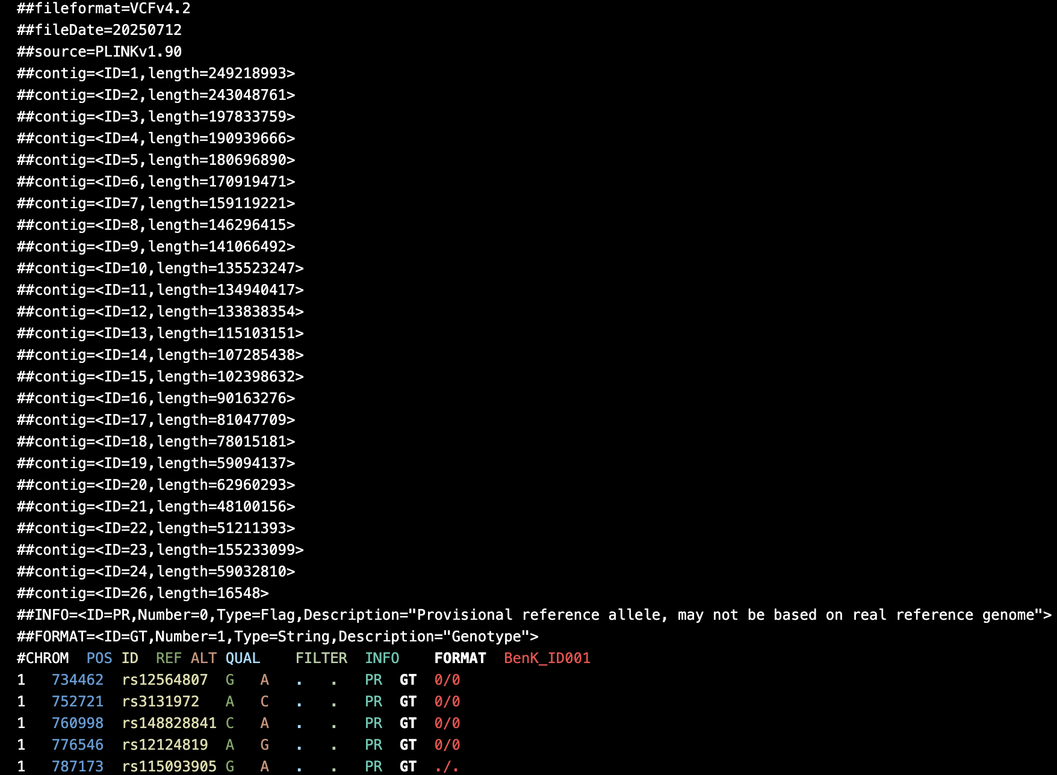
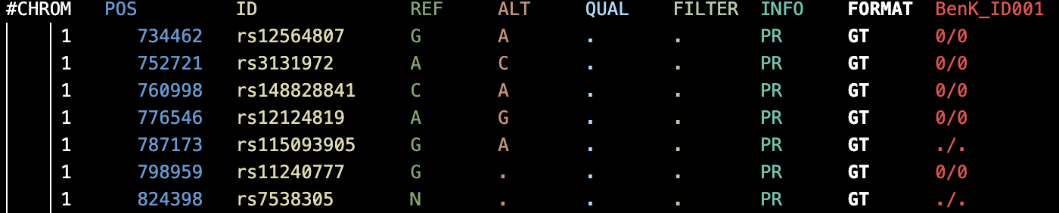
Variant Calling Format
Mandatory Columns for VCFs to be correctly read
ID: The chromosome/contig identifier
length: The total length of that chromosome in base pairs
A standard file format for storing both genetic variants - like SNPs, insertions, and deletions - along with their chromosomal positions and associated metadata, making it the go-to format for sharing genomic variation data
Optional headers of annotations or changes made to the VCF

Slide 5
How do I know what Build my dataset is in?

Slide 6
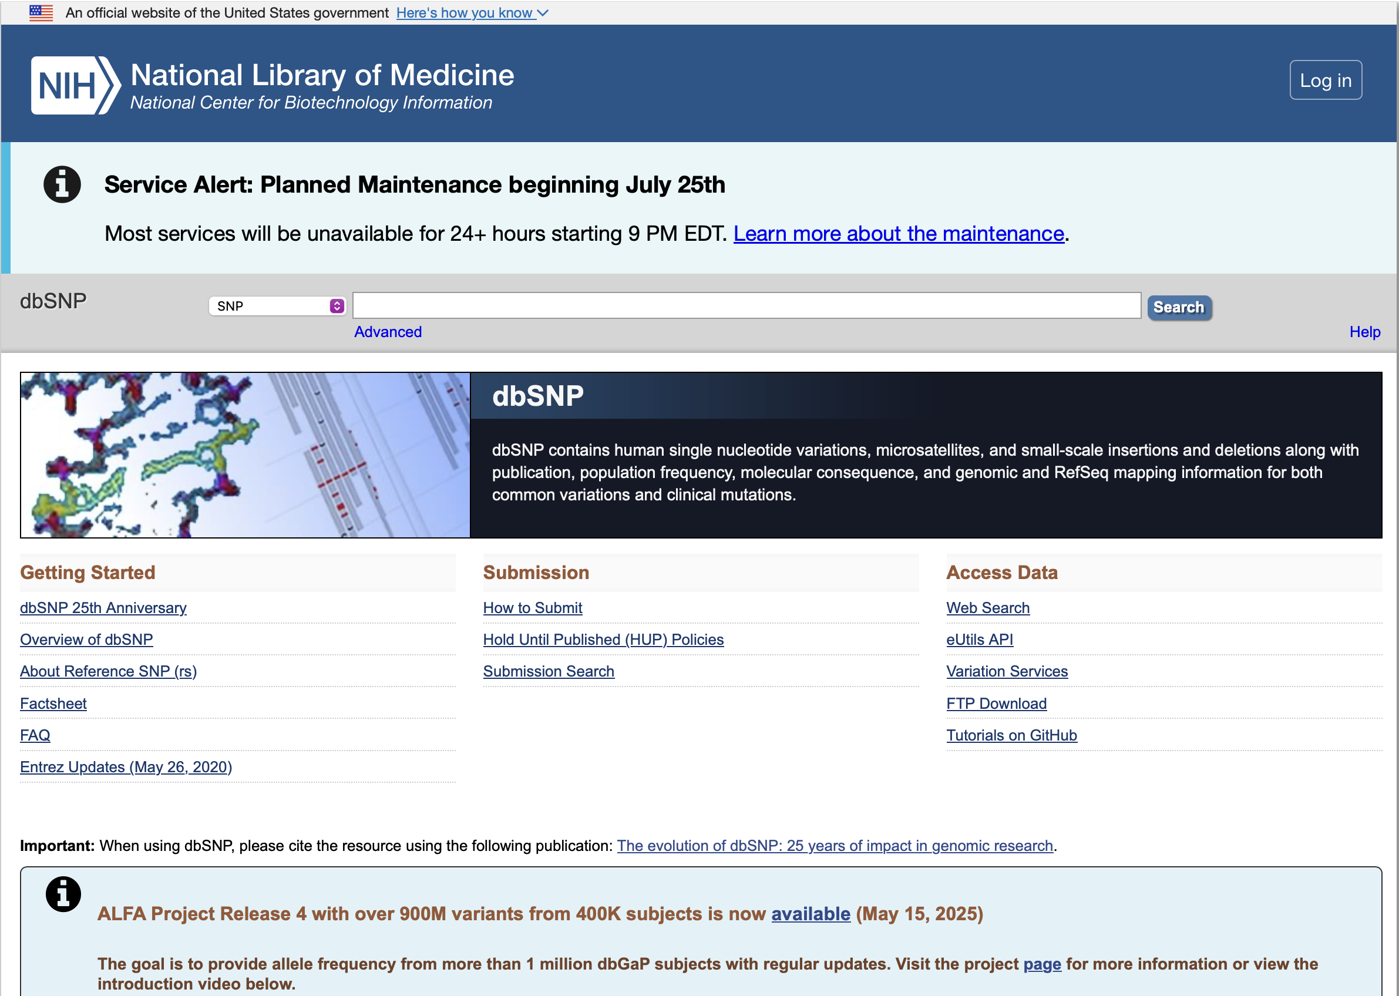
How do I know what Build my dataset is in?
dbSNP

Slide 7
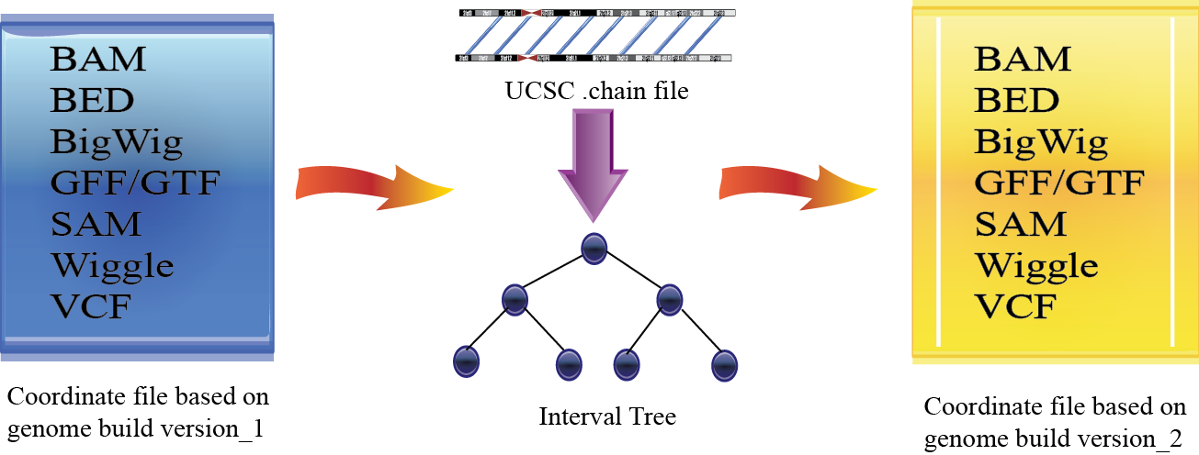
What is liftover?
CrossMap

Slide 8
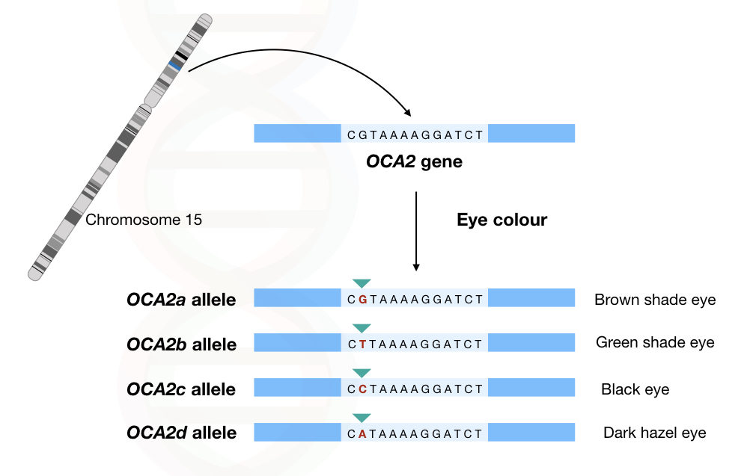
What do we mean by reference allele?
https://geneticeducation.co.in/gene-vs-allele/

Slide 9
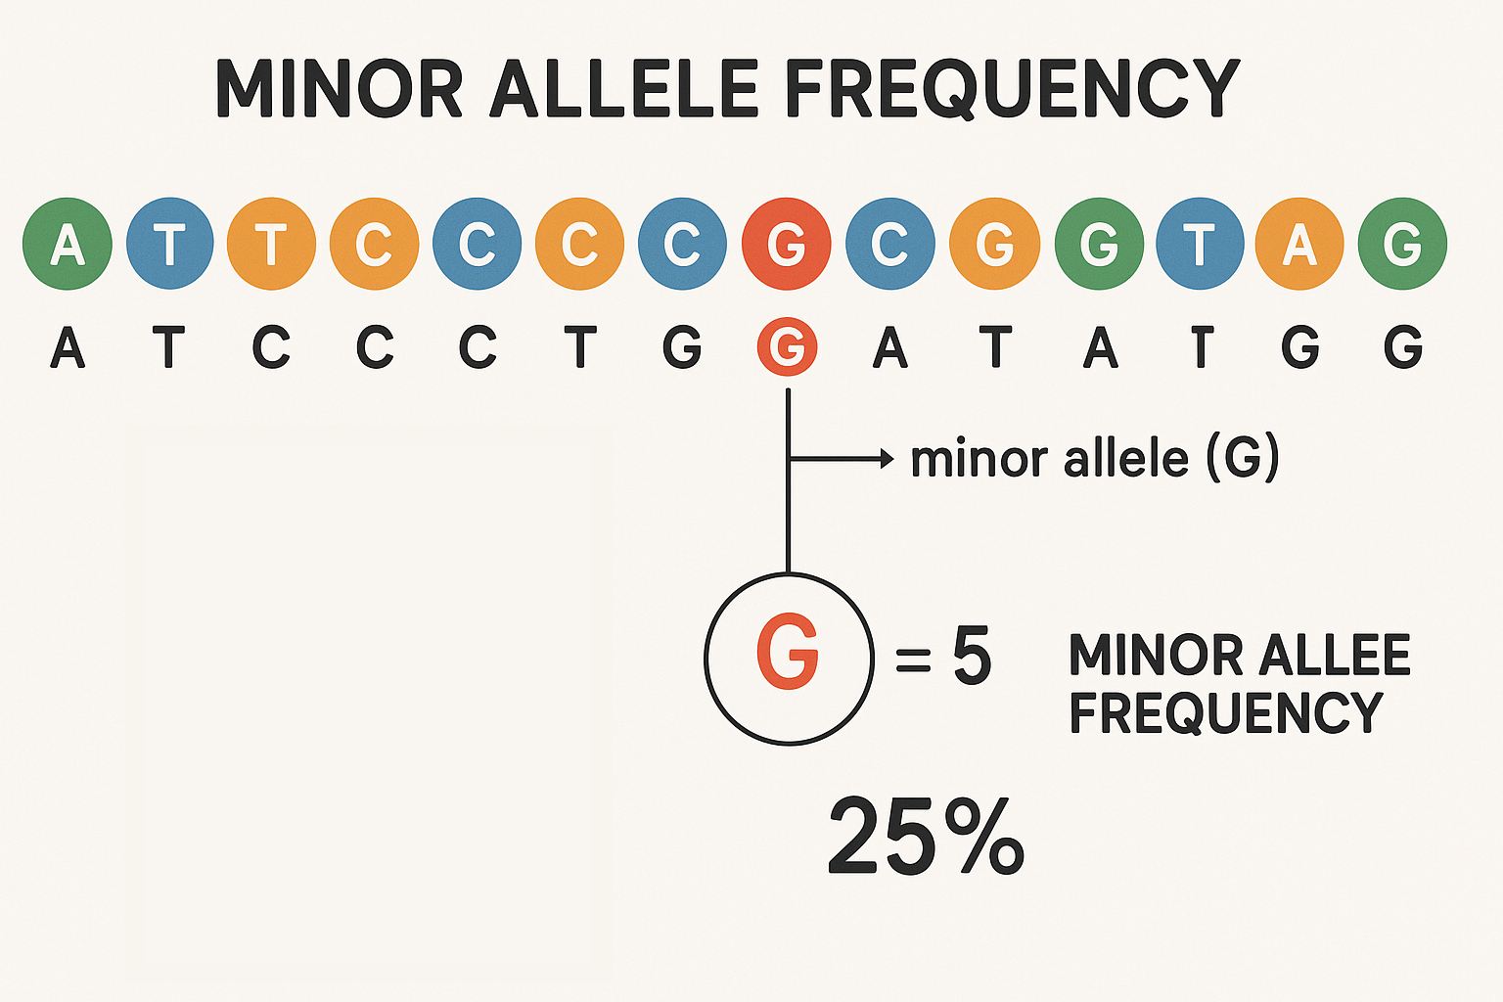
What is Minor Allele Frequency?

Slide 10
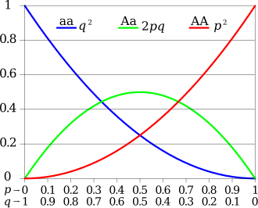
Hardy-Weinberg Equilibrium
Hardy-Weinberg equilibrium describes the relationship between allele frequencies and genotype frequencies in an idealized population
No mutations
No gene flow
Infinite population size Random mating
No natural selection
We filter out variants that statistically deviate from Hardy-Weinberg Equilibrium, as these typically indicate technical issues as opposed to biological phenomena
Does anyone know what those ideal conditions are?

Slide 11
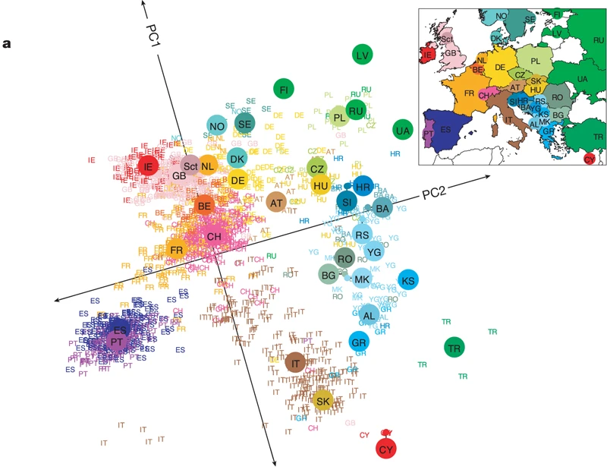
Principal Component Analysis (PCA)
PCA is a statistical method that reduces the complexity of datasets by finding the main patterns of variation.
PCA is often used to examine population structure and ancestry patterns from genome-wide SNP data
10.1038/nature07331

Slide 12
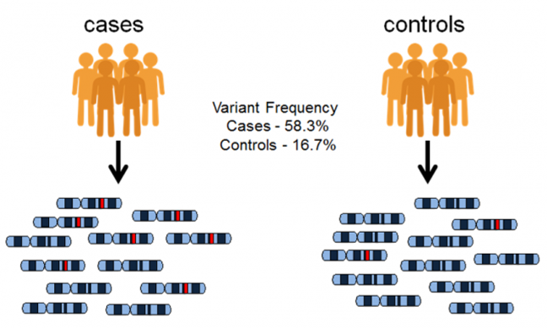
Genome-Wide Association Studies (GWAS)
Genome-Wide Association Studies (GWAS) scan the entire genome to identify genetic variants associated with diseases or traits
Because we are making hundreds of thousands to millions of comparisons, we use a different p value threshold
https://www.ebi.ac.uk/training/online/courses/gwas-catalogue-exploring-snp-trait-associations/what-is-gwas-catalog/what-are-genome-wide-association-studies-gwas/

Slide 13
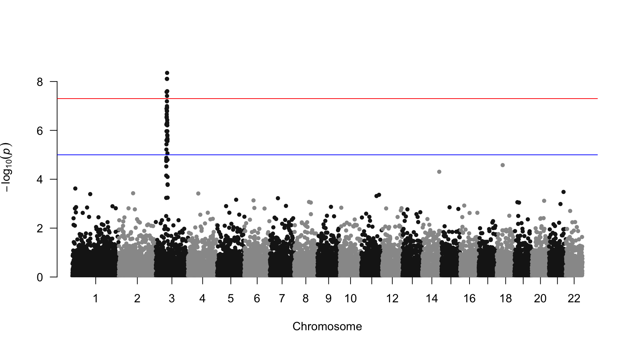

Manhattan Plots
Notes:
It transforms many correlated variables into fewer uncorrelated "principal components" that capture the maximum amount of variance in the data, making it easier to visualize and analyze large datasets.

